Slide 1
Activities of Purbottar Vikash Parishad (CCI)
From 1st March, 2021 to 31st July, 2021

Slide 2
Name of the CCI: Purbottar Vikash Parishad Total No. of Inmates: 112 Nos. Total No of Teaching Staff: 14 Nos. Total No of Supporting Staff: 11 Nos.

Slide 3
Total number of child => 112 Class - I => 04 Class - II => 06 Class – III => 12 Class- IV => 11 Class- V => 12 Class- VI => 25 Class- VII => 13 Class- VIII => 10 Class- IX => 09 Class- X => 06 Class – XI => 04

Slide 4
DOCUMENTS ARE AVAILABLE OF CHILD 1. Birth Certificate- 93 Child 2. Bank Account – 89 3. Addhar Card - 102

Slide 5
Purvottar Vikash Parishad providing following services:
Residential Services
Formal Educational services
Extra curriculum activities:
Harmonium
Tabala
Satriya Nitya
National Credit Crops Training (NCC)
Football Coaching
Art coaching
Vocational Training :
Computer Education

Slide 6
Purbottar Vikash Parishad providing following services:
To ensure the following rights of the Children:
Right to Survival
Right to protection
Right to development
Right to participation

Slide 7
Some of the Good Practices at the PVP
Regular conducting Health Check up of Children.
Annual education tour of the Children.
Providing extra curriculum activates to the inmates accordingly their interest.
Celebration of different festivals at the CCI.
Leadership growth training among the inmates of the CCI.
Conducting exposure visit and carrier counseling class by the different professionals i.e. Army officers, Govt. Officers, literary person, Doctors, Engineers, Wing Commander etc.

Slide 8
Art Competition on 3rd March 2021 on the occasion of Child Protection Day

Slide 9
Observance of “Child Protection Day” 2021 on 4th March by District Child Protection Unit

Slide 10
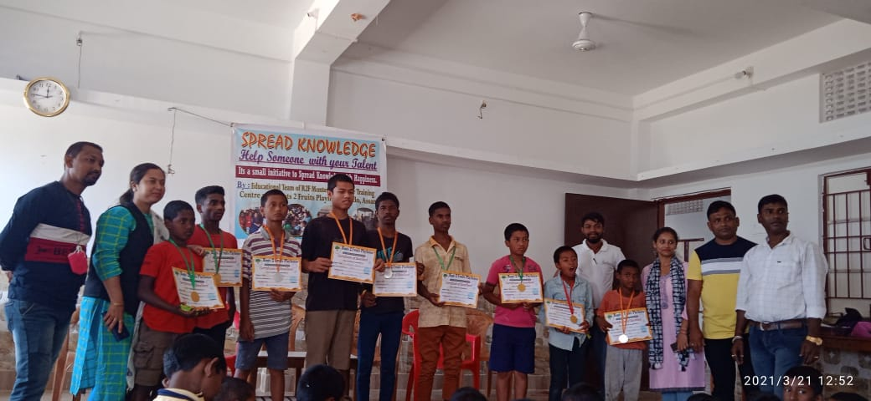
Prize distribution by Education Team, Assam to the winners of “Spread Knowledge” on 21-03-2021

Slide 11
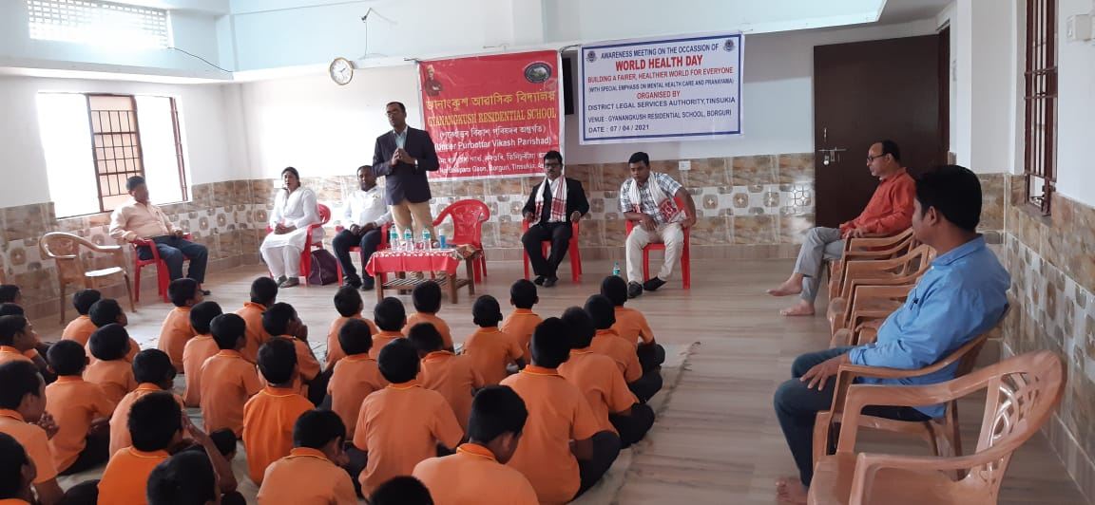
OBSERVANCE OF WORLD HEALTH DAY ON 7-4-2021 BY DLSA, TINSUKIA

Slide 12
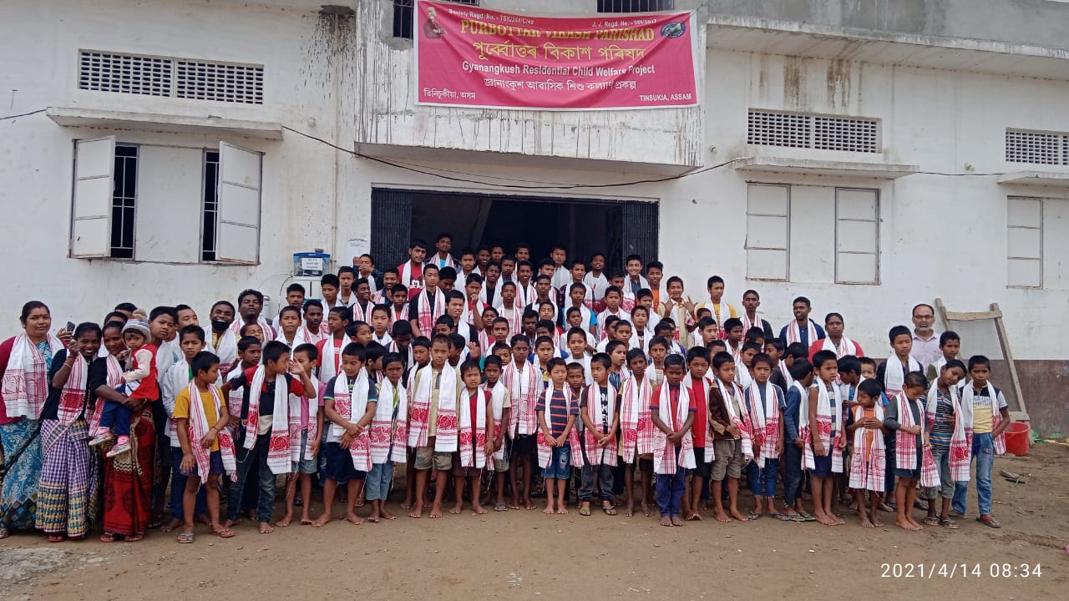
BOHAG BIHU 14-4-2021

Slide 13
Tree Plantation on the occasion of World Environment Day on 5th June, 2021

Slide 14
Observance of Rabha Diwas on 20th June, 2021

Slide 15
Observance of YOGA DAY on 21st June, 2021

Slide 16
Awareness Programme conducted by NHM, Tinsukia on 27th June, 2021

Slide 17
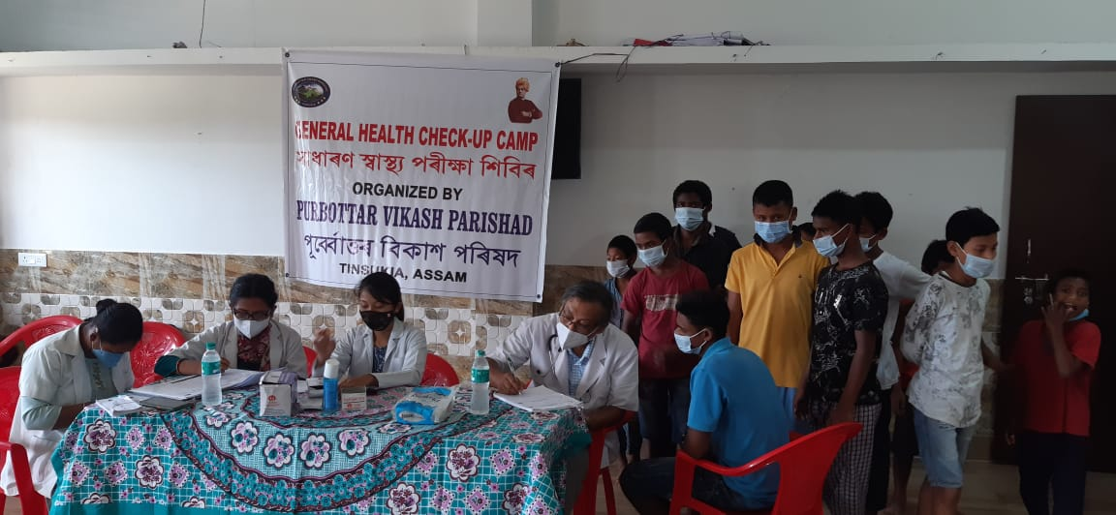
Periodic Health Check up of inmates by NHM, Tinsukia

Slide 18
An Art Competition was conducted by the Indian Army on 20th July, 2021 on the occasion of Vijay Diwas

Slide 19
Donation of Essential Commodities under CSR project on 26th July, 2021 by State Bank of India

Slide 20
Participation at Online Awareness programme on Child related issues organized by Educational Team, Assam

Slide 21
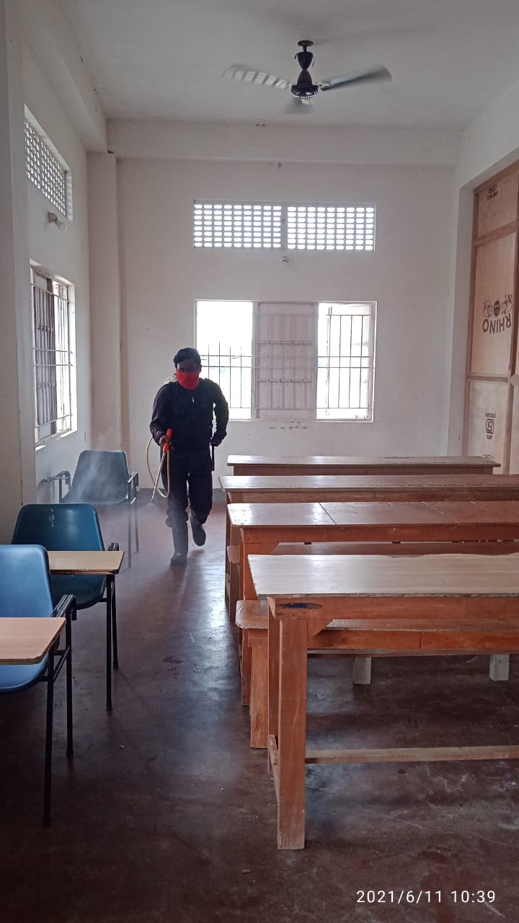
Regular Sanitization of CCI

Slide 22
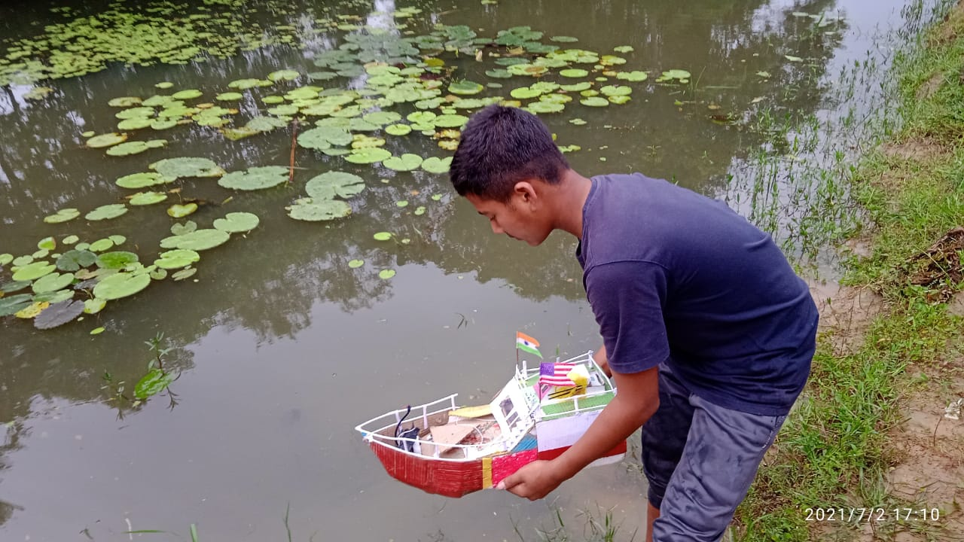
Initiative of scientific creativity of a student of Class IX

Slide 23
Group Counseling Session conducted by CWC Member

Slide 24
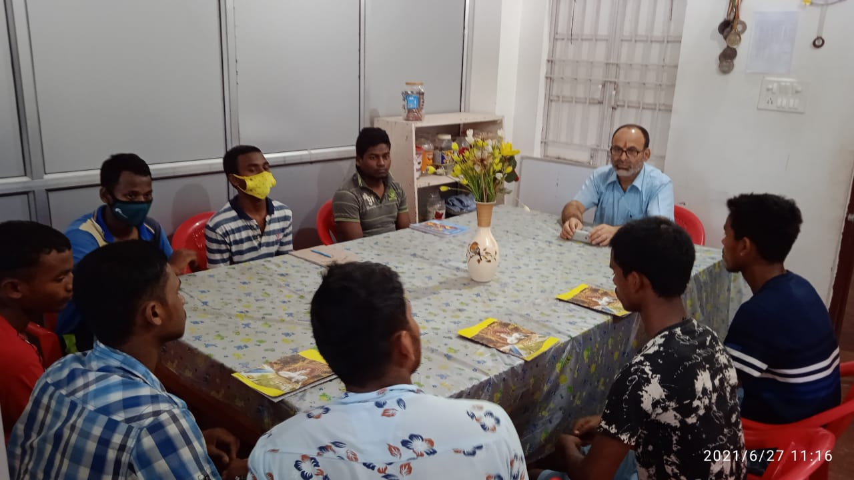
Leadership Development Training among the Children

Slide 25
Sports activity of Children

Slide 26
Sports activities of Children

Slide 27
Regular Physical Training of Children

Slide 28
Felicitation of HSLC Passed student (100% achievement in 2021)

Slide 29
Thank You

